Slide 1

Machine Learning Overview
Stephen McLaughlin
PhD Student

Slide 2

Stephen McLaughlin / @SteveMcLaugh
Notes:
This is not an option.

Slide 3
 | Feature 1 | Feature 2 | Feature 3 | Feature 4
Label A | 11.3166 | 13.1009 | 17.1638 | 1.2876
Label A | 0.0023 | 8.9224 | 7.3368 | 12.826
Label A | 13.9563 | 11.0516 | 8.5414 | 14.0572
Label A | 1.7851 | 9.1011 | 10.7928 | 4.5441
Label B | 12.0978 | 10.4598 | 5.7786 | 12.4596
Label B | 0.28 | 17.3005 | 3.7776 | 11.1616
Label B | 7.3366 | 13.3285 | 13.3285 | 17.5108
Label B | 7.1498 | 13.6181 | 13.391 | 7.3366
Label B | 10.9546 | 6.7191 | 13.0848 | 3.9394
Stephen McLaughlin / @SteveMcLaugh
Notes:
This is not an option.

Slide 4
Stephen McLaughlin / @SteveMcLaugh
Notes:
This is not an option.

Slide 5
Stephen McLaughlin / @SteveMcLaugh
Notes:
This is not an option.

Slide 6
Types of machine learning
Regression
output: a number
Stephen McLaughlin / @SteveMcLaugh
Notes:
#metadatagoals

Slide 7
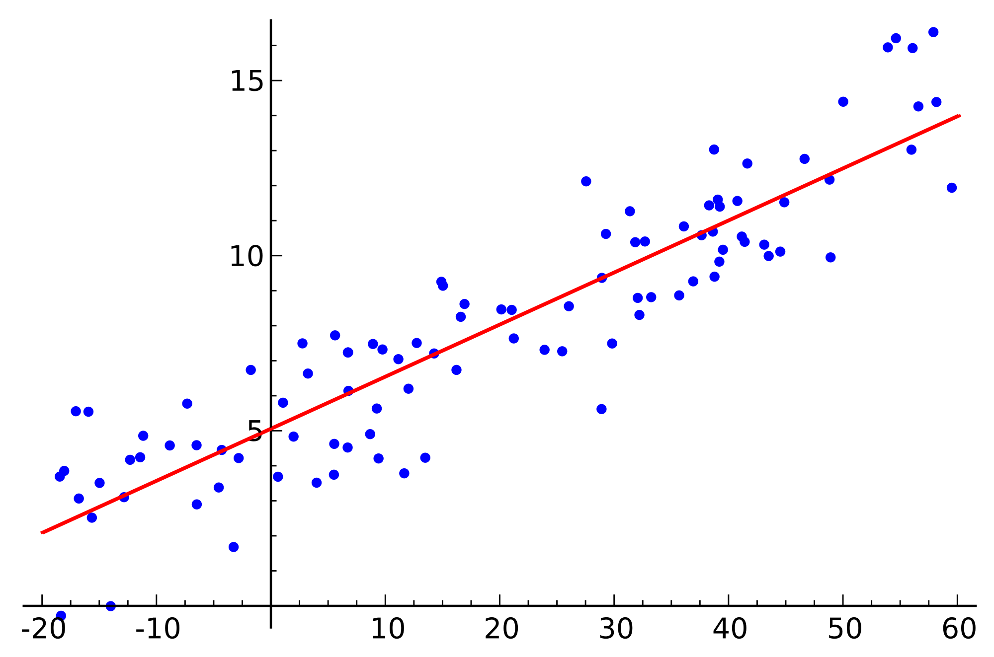
Linear Regression
numbers in, numbers out
Wikimedia Commons
Stephen McLaughlin / @SteveMcLaugh
Notes:
https://commons.wikimedia.org/wiki/File:Linear_regression.svg

Slide 8
Types of machine learning
Regression
output: a number
Classification
output: a class (i.e., category)
Stephen McLaughlin / @SteveMcLaugh
Notes:
#metadatagoals

Slide 9
Types of machine learning
Supervised learning
starting with labeled training data
Stephen McLaughlin / @SteveMcLaugh
Notes:
#metadatagoals

Slide 10
Types of machine learning
Supervised learning
starting with labeled training data
Unsupervised learning
inferring relationships without class labels
Stephen McLaughlin / @SteveMcLaugh
Notes:
#metadatagoals

Slide 11
Types of machine learning
Supervised learning
starting with labeled training data
Unsupervised learning
inferring relationships without class labels
Reinforcement learning
neural networks
Stephen McLaughlin / @SteveMcLaugh
Notes:
#metadatagoals

Slide 12
Model
Training set
Algorithm
Validation set
Test set
Real world
Stephen McLaughlin / @SteveMcLaugh
Notes:
#metadatagoals

Slide 13
K nearest neighbor
Grus, Data Science from Scratch (2015)
Stephen McLaughlin / @SteveMcLaugh
Notes:
#metadatagoals

Slide 14
K nearest neighbor
the curse of dimensionality
intuitive, but not very efficient
Grus, Data Science from Scratch (2015)
Stephen McLaughlin / @SteveMcLaugh
Notes:
#metadatagoals

Slide 15
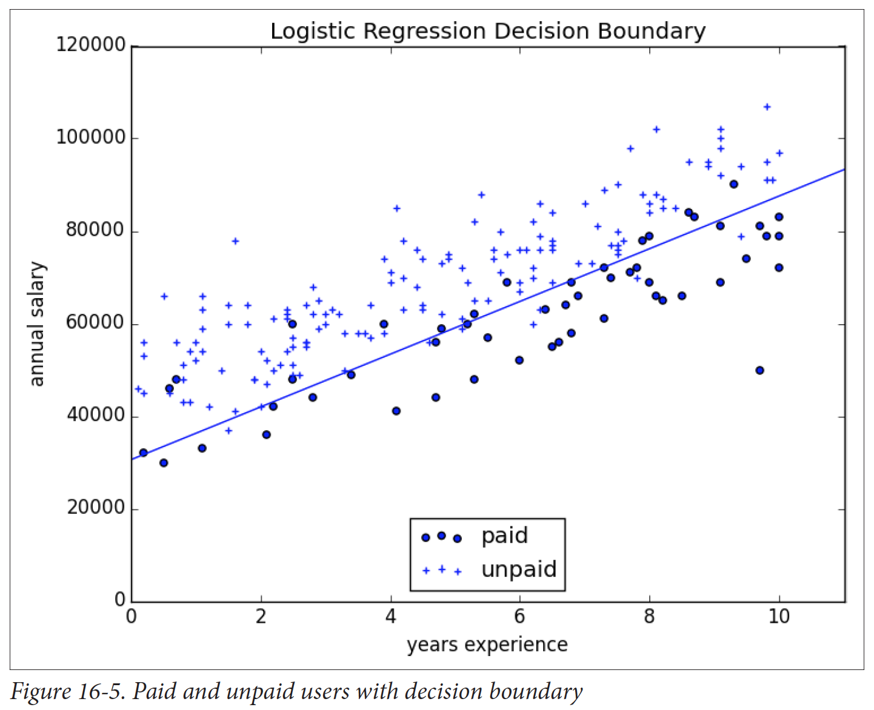
Logistic regression
numbers in, classes out
Grus, Data Science from Scratch (2015)
Stephen McLaughlin / @SteveMcLaugh
Notes:
Gradient boosting is a version of decision trees ... like they cut off the teee at some point?Both random forest and gradient boosting are optimization of decision trees

Slide 16
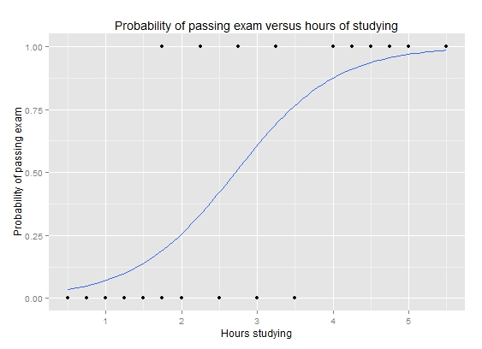
Logistic regression
numbers in, classes out
Wikimedia Commons
Stephen McLaughlin / @SteveMcLaugh
Notes:
Gradient boosting is a version of decision trees ... like they cut off the teee at some point?Both random forest and gradient boosting are optimization of decision trees

Slide 17
Logistic regression
prone to overfitting (i.e., training data not representative of real world)
Wikimedia Commons
Stephen McLaughlin / @SteveMcLaugh
Notes:
Gradient boosting is a version of decision trees ... like they cut off the teee at some point?Both random forest and gradient boosting are optimization of decision trees

Slide 18
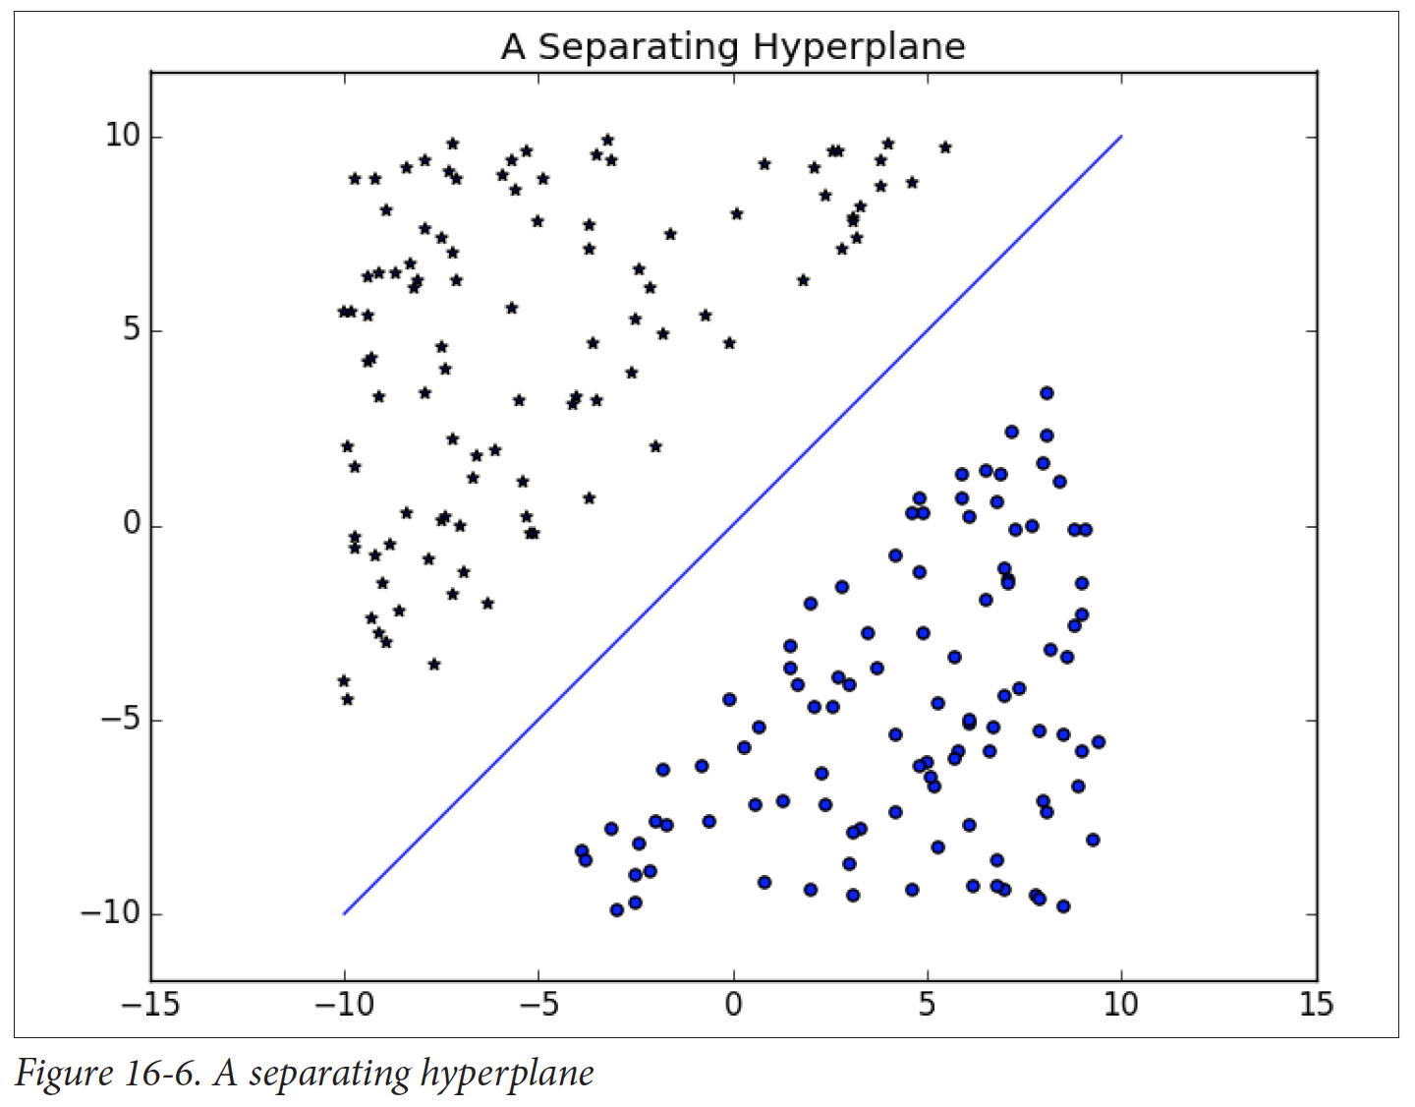
Support
vector
machine
(SVM)
searching for a way to create a wide boundary between classes
Grus, Data Science from Scratch (2015)
Stephen McLaughlin / @SteveMcLaugh
Notes:
SVM
"This is the idea behind the support vectormachine, which finds the hyperplane that maximizes the distance to the nearest pointin each class (Figure 16-6)."- data science from scratch

Slide 19
Support
vector
machine
(SVM)
fast and pretty good in a wide range of applications
Grus, Data Science from Scratch (2015)
Stephen McLaughlin / @SteveMcLaugh
Notes:
SVM
"This is the idea behind the support vector machine, which finds the hyperplane that maximizes the distance to the nearest point in each class (Figure 16-6)."- data science from scratch

Slide 20
Decision
trees
if x, then y …
Grus, Data Science from Scratch (2015)
Stephen McLaughlin / @SteveMcLaugh
Notes:
#metadatagoals

Slide 21
Decision
trees
highly interpretable results
slower than SVMs
random forests and gradient boosting are improved variations
Grus, Data Science from Scratch (2015)
Stephen McLaughlin / @SteveMcLaugh
Notes:
#metadatagoals

Slide 22
Gaussian
mixture
models
assuming that groups of observations will be normally distributed
Zhu, Yu's Machine Learning Garden (2015)
Stephen McLaughlin / @SteveMcLaugh
Notes:
http://yulearning.blogspot.com/

Slide 23
Gaussian
mixture
models
good for reasoning about shades of gray
Zhu, Yu's Machine Learning Garden (2015)
Stephen McLaughlin / @SteveMcLaugh
Notes:
#metadatagoals

Slide 24
Neural networks
Wikimedia Commons
Stephen McLaughlin / @SteveMcLaugh
Notes:
#metadatagoals

Slide 25
Neural networks
“the future”
output not interpretable
slow, expensive, steep learning curve
Wikimedia Commons
Stephen McLaughlin / @SteveMcLaugh
Notes:
#metadatagoals

Slide 26
 | Feature 1 | Feature 2 | Feature 3 | Feature 4
Label A | 11.3166 | 13.1009 | 17.1638 | 1.2876
Label A | 0.0023 | 8.9224 | 7.3368 | 12.826
Label A | 13.9563 | 11.0516 | 8.5414 | 14.0572
Label A | 1.7851 | 9.1011 | 10.7928 | 4.5441
Label B | 12.0978 | 10.4598 | 5.7786 | 12.4596
Label B | 0.28 | 17.3005 | 3.7776 | 11.1616
Label B | 7.3366 | 13.3285 | 13.3285 | 17.5108
Label B | 7.1498 | 13.6181 | 13.391 | 7.3366
Label B | 10.9546 | 6.7191 | 13.0848 | 3.9394
Stephen McLaughlin / @SteveMcLaugh
Notes:
This is not an option.

Slide 27
X = [[11.3166, 13.1009, 17.1638, 1.2876],
[0.0023, 8.9224, 7.3368, 12.826],
[13.9563, 11.0516, 8.5414, 14.0572],
[1.7851, 9.1011, 10.7928, 4.5441],
[12.0978, 10.4598, 5.7786, 12.4596],
[0.28, 17.3005, 3.7776, 11.1616],
[7.3366, 13.3285, 13.3285, 17.5108],
[7.1498, 13.6181, 13.391, 7.3366],
[10.9546, 6.7191, 13.0848, 3.9394]]
y = [0, 0, 0, 0, 1, 1, 1, 1, 1, 1]
Stephen McLaughlin / @SteveMcLaugh

Slide 28
X = [[11.3166, 13.1009, 17.1638, 1.2876],
[0.0023, 8.9224, 7.3368, 12.826],
[13.9563, 11.0516, 8.5414, 14.0572],
[1.7851, 9.1011, 10.7928, 4.5441],
[12.0978, 10.4598, 5.7786, 12.4596],
[0.28, 17.3005, 3.7776, 11.1616],
[7.3366, 13.3285, 13.3285, 17.5108],
[7.1498, 13.6181, 13.391, 7.3366],
[10.9546, 6.7191, 13.0848, 3.9394]]
y = [0, 0, 0, 0, 1, 1, 1, 1, 1, 1]
from sklearn.svm import SVC
svm_classifier = SVC(kernel='linear')
svm_classifier.fit(X, y)
svm_classifier.predict([[4.4, 9.1, 2.2, 3.2], [1.1, 2.8, 4.1, 0.4]])
Stephen McLaughlin / @SteveMcLaugh

Slide 29
Stephen McLaughlin / @SteveMcLaugh

Slide 30
Stephen McLaughlin / @SteveMcLaugh
Notes:
This is not an option.

Slide 31
Bottlenecks to wide application
Compute time
Existing metadata quality
Human ML training time
Technical literacy
Copyright restrictions
Stephen McLaughlin / @SteveMcLaugh

Slide 32
Changes in the past 5 years
Processors are faster.
Storage is cheaper.
VPSes are friendlier.
More and better core ML tools.
More and better high-level wrappers.
GitHub and Stack Overflow are much larger.
Stephen McLaughlin / @SteveMcLaugh

Slide 33
Stephen McLaughlin / @SteveMcLaugh
Notes:
SVM
"This is the idea behind the support vectormachine, which finds the hyperplane that maximizes the distance to the nearest pointin each class (Figure 16-6)."- data science from scratch

Slide 34
Stephen McLaughlin / @SteveMcLaugh

Slide 35
Stephen McLaughlin / @SteveMcLaugh
Notes:
This is not an option.

